Slide 1

CULTURAL DIVERSITY WE

Slide 2
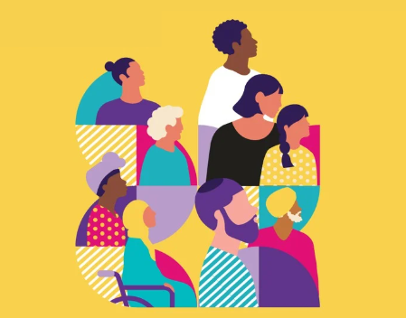
Acknowledgement of Country | 3
Introduction | 4
What you can do to help | 5
Key messaging | 6
Spread the word | 7
Cultural Diversity Week details | 8
Victorian Multicultural Festival | 9
Creative assets to be shared | 10-18
Key milestones | 19-20
VMC partners and sponsors | 21
Contact | 22
Contents

Slide 3
Acknowledgement of Country
We acknowledge the Traditional Custodians of the land and pay our respects to their Elders, past and present, and extend that respect to all Aboriginal and Torres Strait Islander peoples.
We recognise their continuing connection to land, waters, and culture, and we honour their invaluable contributions to the rich cultural diversity of Victoria.

Slide 4

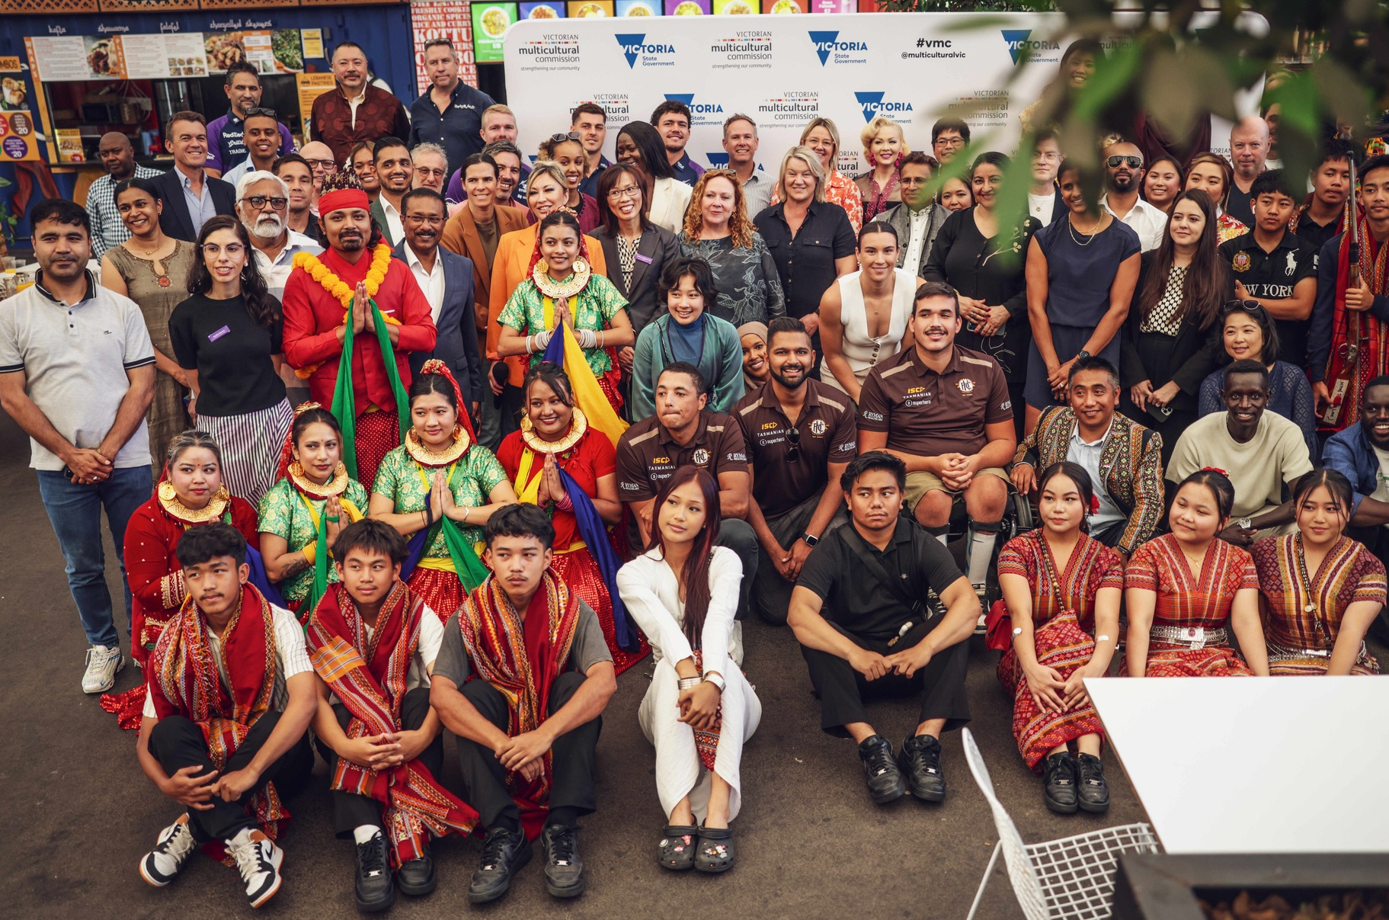
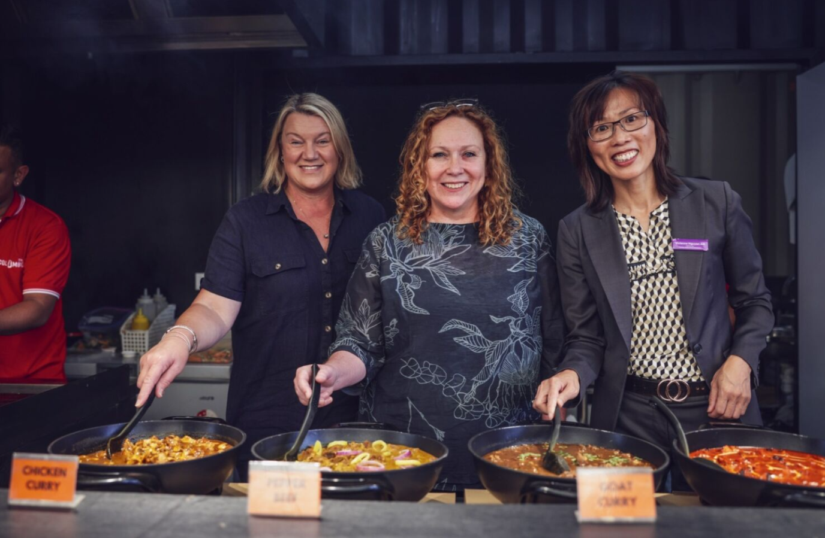
Introduction
Cultural Diversity Week (CDW) is Victoria’s leading multicultural celebration, held annually to coincide with the United Nations International Day for the Elimination of Racial Discrimination and Harmony Day on 21 March.
Held from 21 to 29 March 2026, CDW will showcase the colourful sounds, flavours, sights and traditions of Victoria’s rich and ever-diversifying communities.
Coordinated by the Victorian Multicultural Commission (VMC), CDW 2026 is dedicated to celebrating the unique journeys and collective stories that define our multicultural identity.
This year’s theme, Culture connects us all, highlights how sharing intercultural stories and experiences fosters understanding, belonging and connection.
The week will feature vibrant events, community-led activities, and educational initiatives that foster understanding, inclusion, and respect across the state.
By participating, stakeholders like you can help bring to life the vision of a more connected and cohesive society, while celebrating the cultural wealth that makes Victoria unique.

Slide 5
Help spread the word!
Help spread the word about Cultural Diversity Week 2026!
Let’s work together to amplify the message and encourage everyone to get involved in this special week of connection, celebration and cultural exchange. Whether you’re a school, workplace, community group or individual, there are countless ways to celebrate and promote the importance of cultural diversity.
You can help to spread the word or become a part of the cultural diversity celebration in the following ways:
SHARE:
Share the materials Engage with your communities and share this stakeholder pack across your networks such as EDMs, social media and WhatsApp, WeChat, Messenger and Facebook groups, and encourage participation
PARTICIPATE:
Host and event or activity
Host your own event / activity or encourage organisations to host an event. Register your event/ activity on VMConnect, the online hub for multicultural events in Victoria
CELEBRATE:
Join the digital campaign
Amplify community voices and stories. Record a short video, photo or narrative, and post it on social media using #CDW2026
ATTEND:
The Victorian Multicultural Festival
Attend the flagship event to celebrate and unite diverse communities, 27 to 29 March at the iconic Grazeland, Spotswood

Slide 6
Key messaging and resources
Cultural Diversity Week (CDW) will launch on Harmony Day and will be held from 21–29 March 2026.
CDW is a statewide celebration of the power, influence and stories of Victoria’s multicultural communities.
Get involved in the celebration! Host or attend a CDW event, participate in an activity or share your cultural story online.
This year’s theme, Culture connects us all, highlights how sharing intercultural stories and experiences fosters understanding, belonging and connection.
Proudly led by the Victorian Multicultural Commission, CDW is an opportunity for individuals, schools, workplaces and communities to come together to celebrate and champion cultural diversity.
The Victorian Multicultural Festival will be held at Grazeland from 27 to 29 March, returning as the pinnacle of the CDW celebrations.
Resources:
Creative assets available here
Cultural Diversity Week website here
Share your event on VMC Connect here
Utilise hashtag: #CDW2026
Tag us on Facebook/ Instagram: @multiculturevic
Tag us on LinkedIn: victorian-multicultural-commission

Slide 7
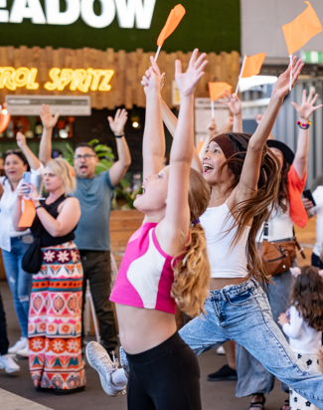
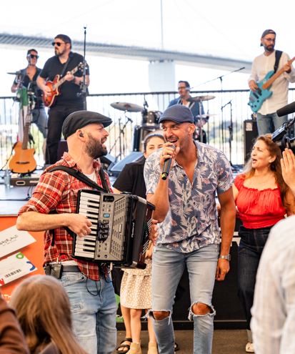
Participate: Host an event or activity for your chance to win!
Whether you’re a government department, community group, school or business, get involved and facilitate your own multicultural event/ activity as part of Cultural Diversity Week. Please see below ideas:
Host a Taste of Harmony lunch catered by a social enterprise
Run a local festival showcasing diverse talents and traditions
Offer hands-on activities like cooking demos, craft sessions and storytelling circles
Partner with your local library for a multicultural Storytime
Collaborate with businesses, schools and community groups to co-create events
Hold a multicultural movie night
Offer language, craft or dance classes
Share books and publications on race, belonging and identity
Create a group playlist featuring music from different cultures
Organise a Harmony Walk
Run a training session with LanguageLoop
Host a lunchtime panel with diverse voices
Hold a traditional dress day celebrating cultural heritage
Prizes to be won!
Upload your activity or event to VMConnect and tag #CDW2026 on socials to be eligible for the prize.
More details can be found here.
Visit the VMC website for more ideas

Slide 8
Celebrate: Join the digital competition
This year’s theme, Culture connects us all, highlights how sharing intercultural stories and experiences fosters understanding, belonging and connection.
We invite you to create a video sharing how you’re learning, celebrating and connecting with another culture during Cultural Diversity Week as a reel, TikTok or social story. There are also prizes to be won!
Be creative! Examples of video content could include:
Cooking or tasting a dish from another culture
Visiting a cultural landmark, gallery, or place of worship
Participating in a cultural dance, art form, or tradition
Learning a word or phrase in another language
Feature different languages spoken in your organisation for an extra meaningful touch.
Have fun and keep it authentic! Personal, creative videos are encouraged. Consider featuring the different languages spoken in your organisation for an extra meaningful touch.
We can’t wait to see how you bring this year’s theme to life and celebrate Victoria’s diversity during Cultural Diversity Week 2026.
Tips on how to film a video:
Keep it short: 30–90 seconds.
Film vertically: Ideal for social media platforms.
Introduce yourself/ your organisation: Name, role, and organisation. Example: “Hello, I’m [Your Name], [Your Role] at [Organisation Name], and we’re proud to celebrate Victoria’s multicultural community.”
Record your multicultural experience: Share an experience, what you learned or how it made you feel.
Nominate someone: Encourage others to join in.
Finish with a commitment: Express pride in being part of Victoria’s multicultural community and your dedication to celebrating diversity.
Share your video: Post the video on your social channels starting 1 March 2026. Tag @multiculturevic and include the hashtag #CDW2026
Visit the VMC website for more details
Please note: If your submission includes footage of individuals under 18, please ensure photo and video consent has been obtained.

Slide 9
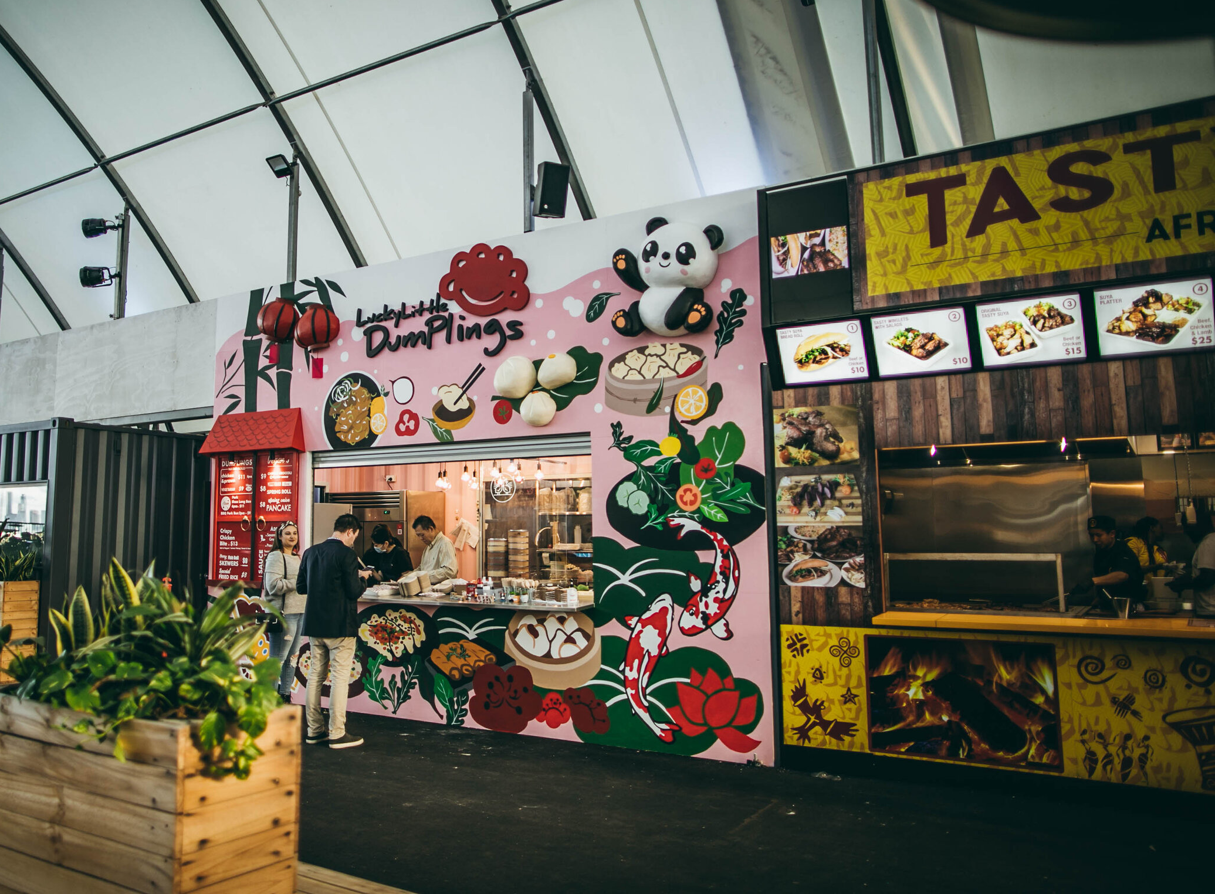
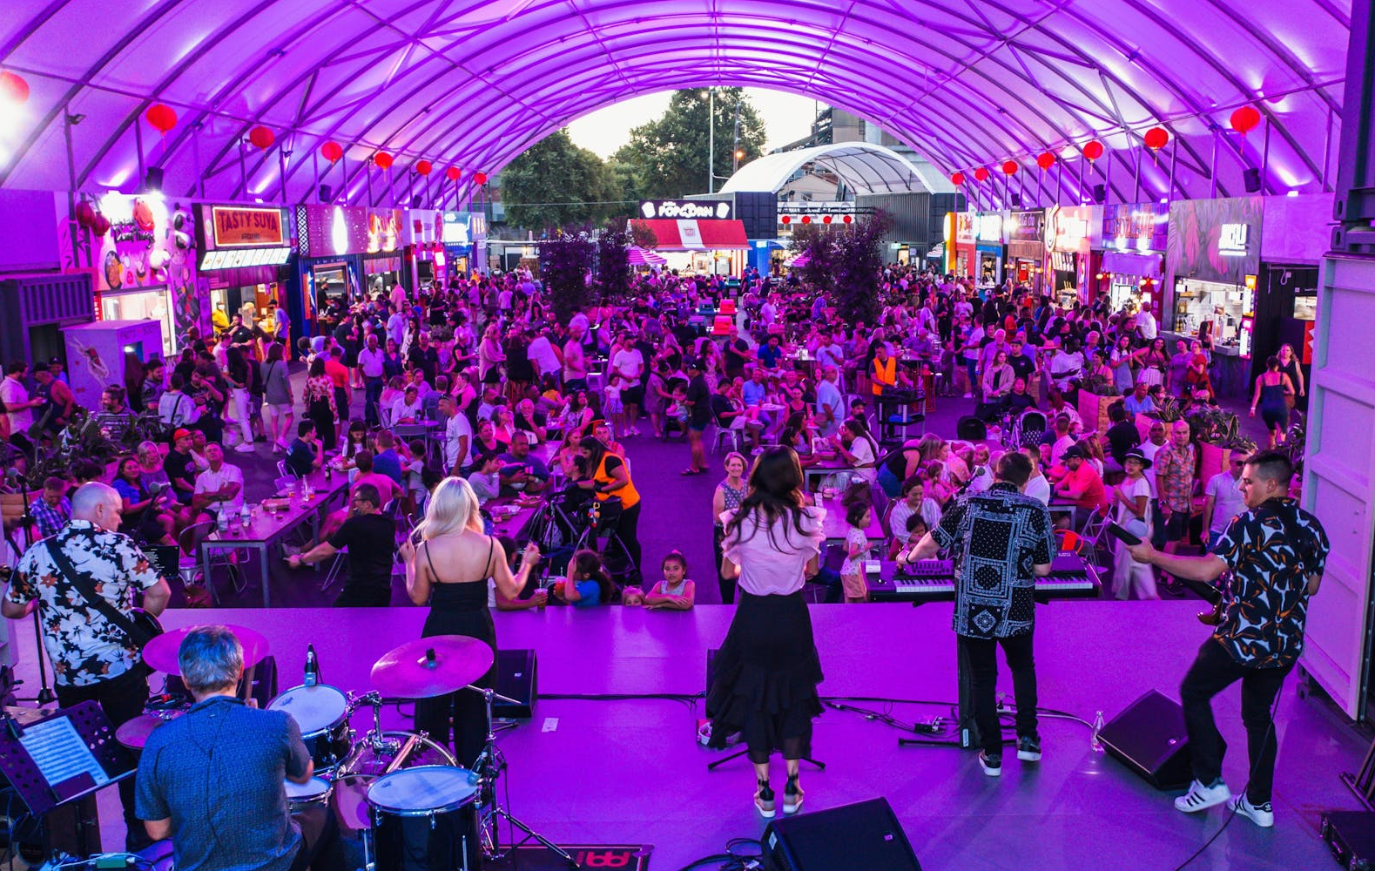
Attend: The Victorian Multicultural Festival
The Victorian Multicultural Festival is a celebration of diversity and multicultural food and entertainment, held from Friday 27 March through to Sunday 29 March 2026.
The Festival will be hosted at Grazeland, a cultural playground for foodies in Spotswood. It will tantalise and excite your senses with a unique outdoor dining experience, sampling cuisine from nations across the world.
With music and performances across several stages, join us on the Friday evening, and Saturday and Sunday from noon onwards.
Wear your best cultural dress or colours to celebrate in style.
Venue: Grazeland
Address: 20 Booker Street, Spotswood
Opening hours:
Friday 27 March: 5:00pm – 10:00pm
Saturday 28 March: 12:00pm – 10:00pm
Sunday 29 March: 12:00pm – 9:00pm
Cost: $4 entry (free for children under 12 years)
No bookings required.

Slide 10
Help promote Cultural Diversity Week

Slide 11
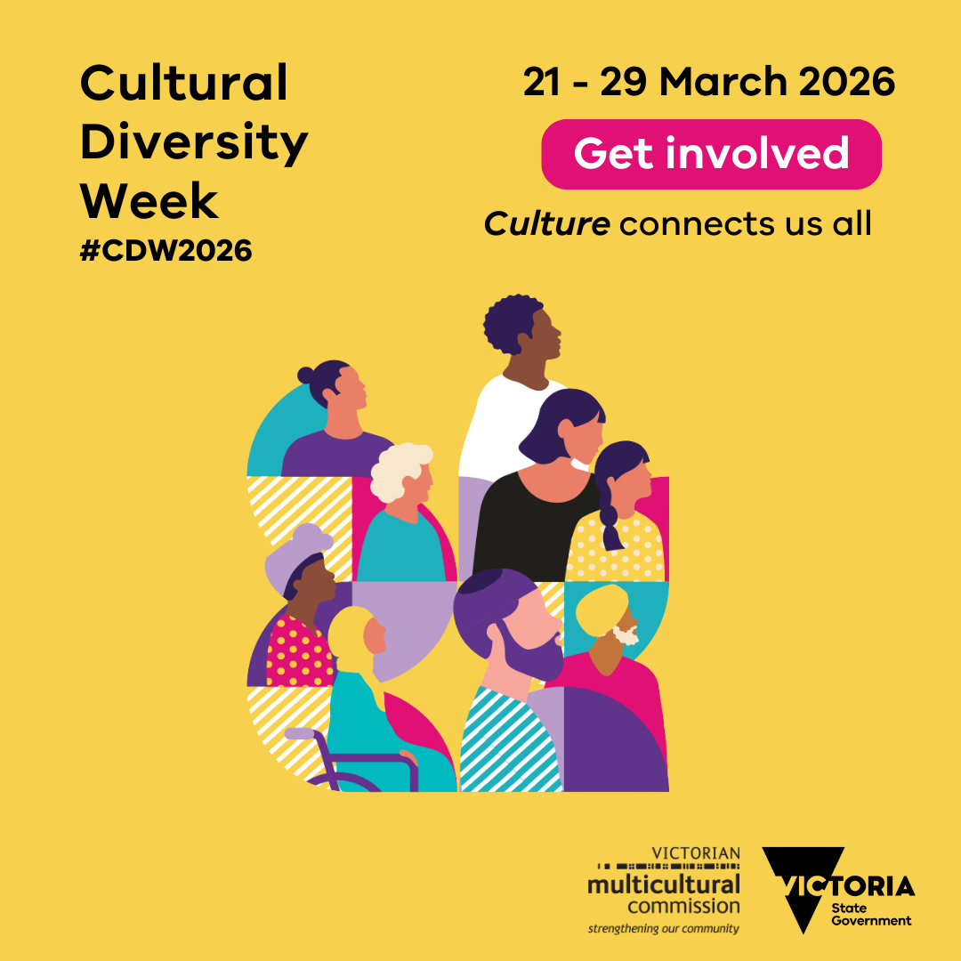
Promote Cultural Diversity Week on your social media channels
Suggested post copy
We’re proud to celebrate Cultural Diversity Week 2026!
From 21–29 March, we’ll join communities across Victoria to celebrate the stories, traditions and contributions that make our state a vibrant multicultural success.
This year’s theme, Culture connects us all, is a powerful reminder of how diversity and inclusion help us build a stronger, more connected future.
Be part of the celebration! Host an event, attend activities or share your cultural story.
Register your event on VMConnect, Victoria’s online hub for multicultural events to be automatically entered into the draw to win some exciting prizes: https://www.multiculturalcommission.vic.gov.au/cultural-diversity-week-victorian-multicultural-commission.
All participants who host an event or activity will be automatically entered into a draw to win some exciting prizes. These include:
2 x VIP tickets to the Multicultural Film Festival Premiere
News story feature on the VMC website and EDM newsletter
Social media coverage
VMC Commissioner to speak at one of your events
A featured spot on the VMC’s social media and website
Let’s come together to celebrate, connect and showcase the incredible multicultural spirit that defines Victoria.
#CulturalDiversityWeek #CDW2026 #CultureConnectsUsAll
Static social tile
Click here to download

Slide 12
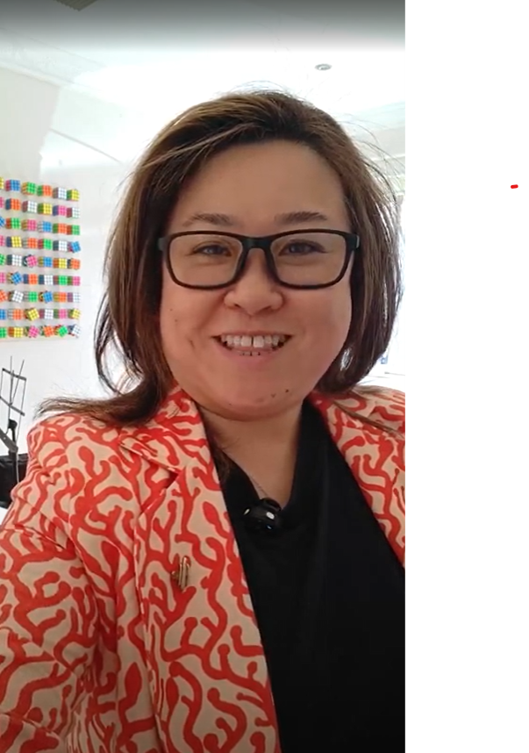
Promote on your social media channels -
Digital campaign
Suggested post copy
Digital content example from
VMC Commissioner, Dr Judy Tang
Join us in celebrating Cultural Diversity Week by sharing your unique cultural stories!
The Victorian Multicultural Commission invites everyone to participate by showcasing intercultural exchanges taking part in languages or meaningful cultural experiences.
Record a short video, capture a photo or write a narrative, then share it on social media using #CDW2026 to be automatically entered into the draw to win some exciting prizes.
Don’t forget to tag @multiculturevic to be featured on our page!
All participants will be entered into an automatic draw to win exciting prizes, including:
2 x VIP tickets to the Multicultural Film Festival Premiere
A featured spot on the Victorian Multicultural Commission’s social media and website
Let’s celebrate the cultures that makes Victoria a unique and vibrant place to live.
#CulturalDiversityWeek #CDW2026 #CultureConnectsUsAll
Click here to watch

Slide 13
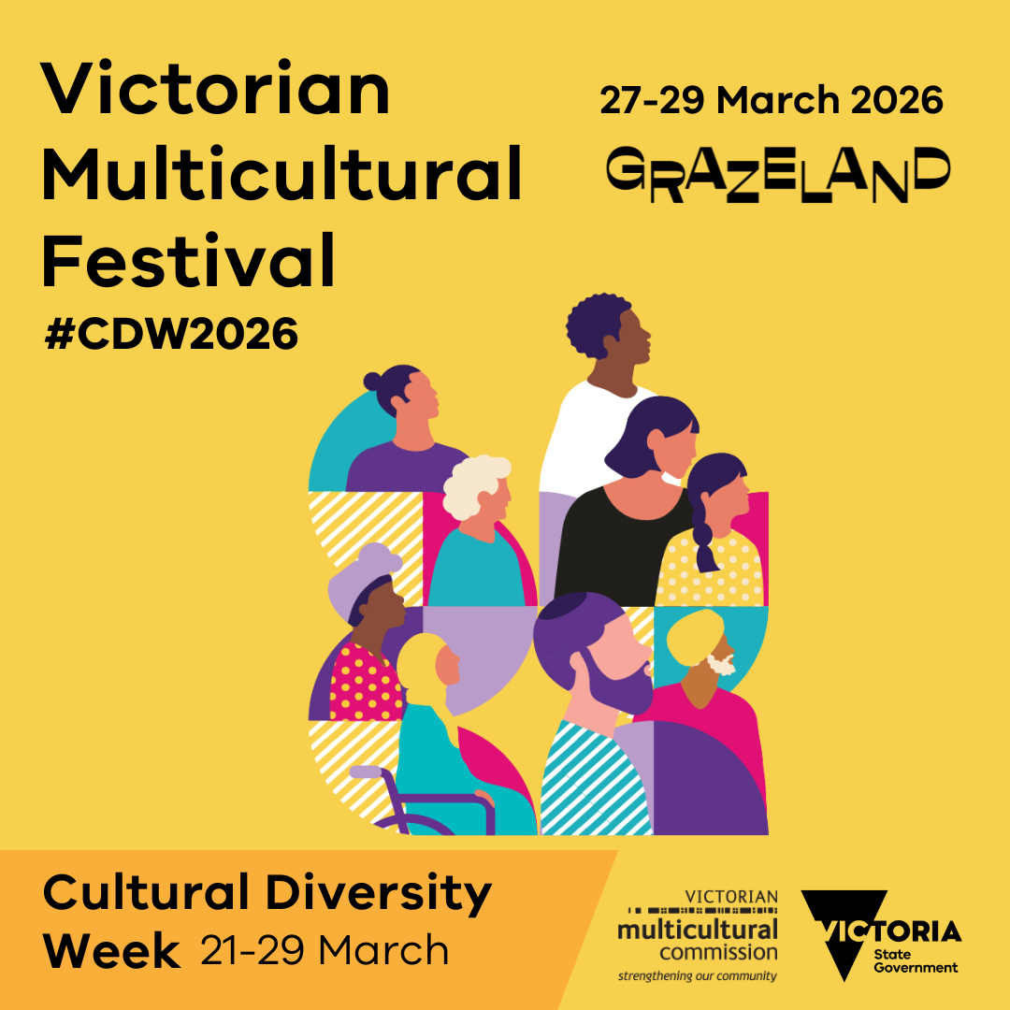

Promote on your social media channels - Victorian Multicultural Festival
Suggested post copy
Join us to celebrate Cultural Diversity Week at the flagship Victorian Multicultural Festival 2026!
Taking place from 27–29 March 2026 at the iconic Grazeland in Spotswood, this vibrant festival is the ultimate celebration of Victoria’s multicultural communities, packed with food, entertainment and culture.
🌍 Explore Global Flavours
Indulge in an outdoor dining experience featuring cuisine from around the globe – perfect for food lovers!
🎶 Non-Stop Entertainment
Enjoy live music, cultural performances and activities for all ages, making it the ideal outing for families and friends.
🎨 Dress for the Occasion
Wear your favourite cultural attire or colours and celebrate diversity in style!
🎟️ Event Highlights
$4 entry fee (children under 12 enter free)
Gates open Friday evening and from noon on Saturday and Sunday
Bring your family and friends – we can’t wait to see you there!
Visit the Cultural Diversity Week website for full event details: https://www.multiculturalcommission.vic.gov.au/cultural-diversity-week-victorian-multicultural-commission
#CulturalDiversityFestival #CulturalDiversityWeek #CDW2026 #CultureConnectsUsAll #Grazeland @grazeland
Static social tile
Animated social story
Click here to download
Click here to download

Slide 14


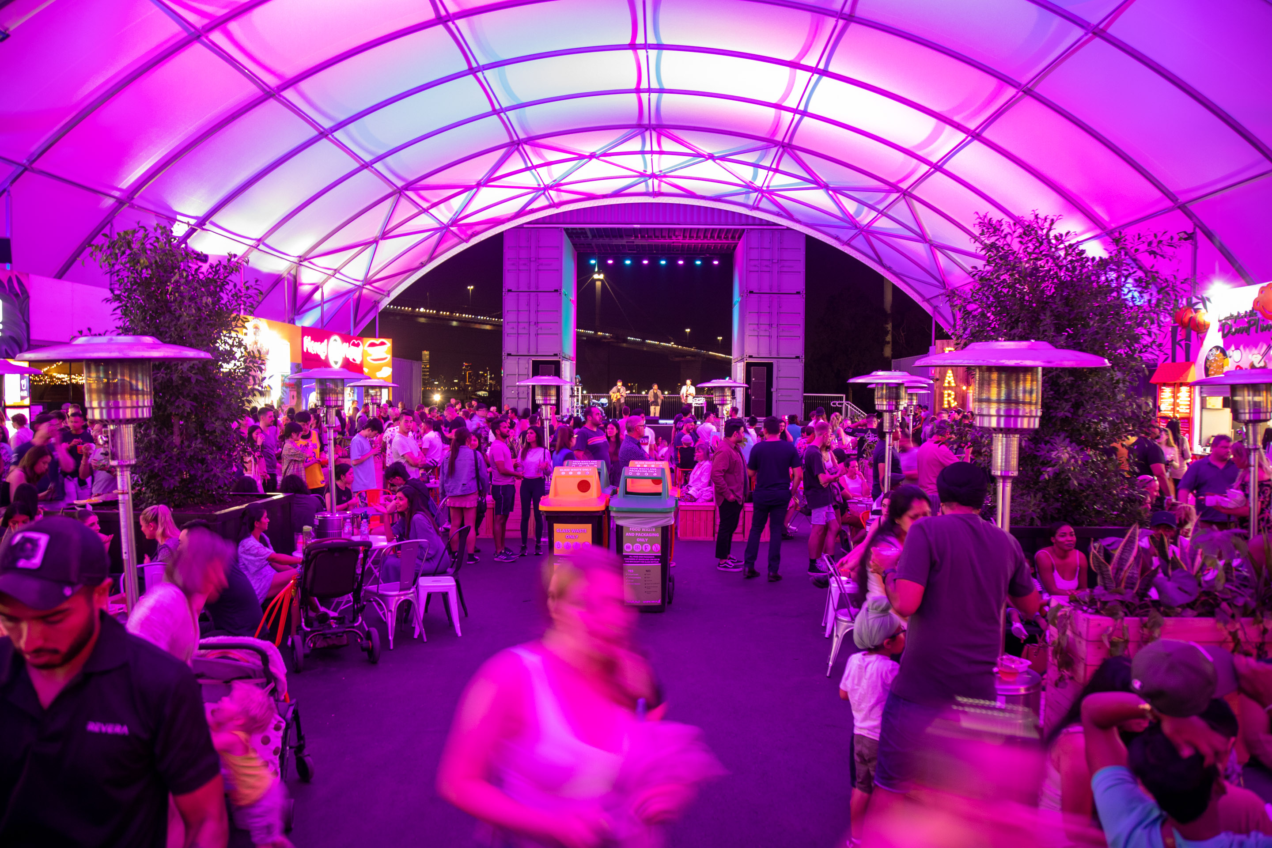
Newsletter header (EDM)
Suggested EDM Content
Get ready for Cultural Diversity Week 2026 — Victoria’s biggest celebration of multiculturalism!
From 21–29 March, immerse yourself in a week of vibrant events, inspiring storytelling and cultural pride, as we come together to honour the stories, traditions and contributions that make Victoria extraordinary.
Whether you’re hosting an event, joining the flagship Victoria Multicultural Festival, or sharing your cultural story online, there’s a way for everyone to get involved.
🌟 Host or Register an Event
Make your community a part of the celebration! Register your event on VMConnect, the online hub for multicultural events in Victoria: Visit the Cultural Diversity Week website for details.
🌟 Be Part of Our Digital Campaign
Celebrate this year’s theme, Culture connects us all, by sharing your unique cultural story. Record a short video, photo or narrative, and post it on social media using #CDW2026 and tag @multiculturevic to be automatically entered into the competition.
🎁 All participants who host and event or create a video will go into a draw to win exciting prizes. See website for more details.
🌟 Join the flagship Victorian Multicultural Festival 2026
Taking place from 27–29 March at the iconic Grazeland in Spotswood, this festival is packed with global flavours, vibrant entertainment and cultural pride:
Indulge in cuisine from around the globe.
Enjoy live music, cultural performances and family-friendly activities.
Wear your favourite cultural attire or colours and celebrate diversity in style!
🎟️ Entry: $4 (children under 12 free)
Let’s celebrate the cultures that makes Victoria a unique and vibrant place to live.
#CulturalDiversityWeek #CDW2026 #CultureConnectsUsAll
Newsletter header

Slide 15

Internal Creative*
Virtual background creative
Email signature
Creative assets available here
*The VMC have developed a Zoom or Microsoft Teams background and email signature to help you promote Cultural Diversity Week .

Slide 16
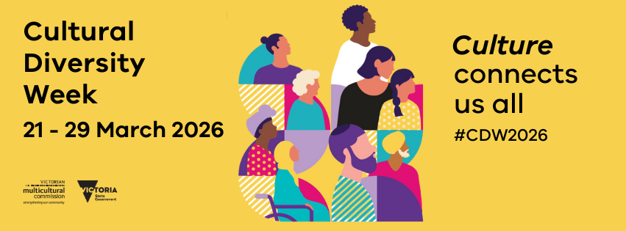

Social Media Banners*
Facebook cover banner
LinkedIn banner
Creative assets available here
*The VMC have developed social media event banners to help promote your events

Slide 17


Promotional poster*
A4/A3 Poster
Creative assets available here
*Please note that posters can be adjusted to be printed in A4 or A3 or can be used as a digital flyer/ screen to promote Cultural Diversity Week

Slide 18
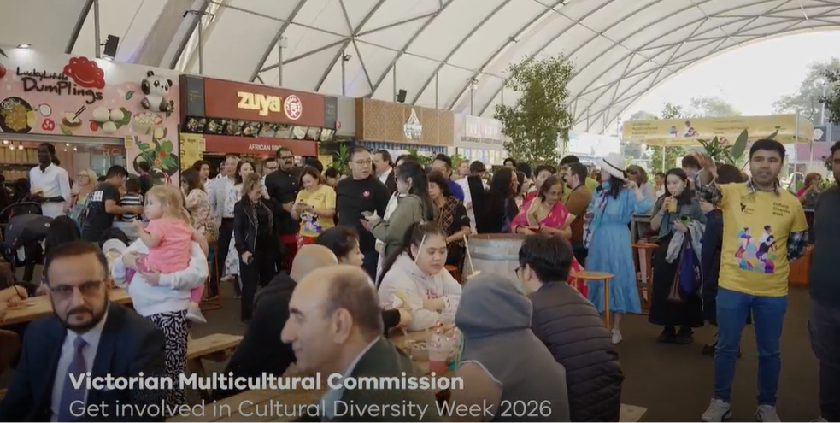
YouTube video
Promotional video
Suggested post copy
We are proud to celebrate Cultural Diversity Week in 2026!
From 21–29 March, we’ll join communities across Victoria to celebrate the stories, traditions and contributions that make our state a vibrant place to live.
This year’s theme, Culture connects us all, is a powerful reminder of how sharing intercultural stories and experiences helps foster understanding, belonging and connection.
Be part of the celebration! Host an event, attend activities and share your experience of engaging with other cultures.
Hear about ways we can come together to celebrate, connect and showcase the incredible multicultural spirit that defines Victoria: https://youtu.be/EpM0eVEhMq8
#CulturalDiversityWeek #CDW2026 #CultureConnectsUsAll
Available on YouTube here
Link to download here

Slide 19
Key milestones*
 | March 2026
MILESTONES | 1 | 8 | 15 | 21 | 29
Entries open for digital campaign: 1 March 2026
Entries close for digital campaign: 29 March 2026
Entries open for participation (Host event/activity): 21 March 2026
Entries close for participation (Host event/activity): 29 March 2026
Cultural Diversity Week begins: 21 March 2026
Victorian Multicultural Festival: 27 to 29 March 2026
Winners announced: 31 March 2026
*The VMC encourages our partners and stakeholders to promote CDW at key milestones leading up to the festival using the assets provided.

Slide 20

CDW coincides with important observances
Cultural Diversity Week occurs in March, which coincides with several important cultural and religious observances, enriching our collective celebration of diversity and inclusion. Here are some examples:
Ramadan (begins evening of 16 February and ends evening of 18 March 2026*):
A sacred month of fasting, prayer and reflection observed by Muslims worldwide.
Holi (Wednesday, 4 March 2026):
A vibrant festival celebrated by the Hindu faith, marking the arrival of spring with colours, music and joy, bringing communities together worldwide.
Harmony Day (Saturday, 21 March 2026):
An Australian celebration promoting inclusiveness, respect and belonging.
Acknowledging and respecting diverse observances:
These important celebrations strengthen CDW and is important to acknowledge these significant observances while celebrating CDW.
We encourage stakeholders to consider these dates and ensure their CDW activities are respectful and inclusive of all cultures and faiths.
*Start and end dates are approximate and may vary by ±2 days, as the start and end of Ramadan are determined by the sighting of the new crescent moon.

Slide 21












Cultural Diversity Week partners and sponsors
Gold Partners
Delivery Partner
Silver Partners
Community Partners

Slide 22

Contact
Thank you
For more information, please contact:
communications@vmc.vic.gov.au
Follow us

